Slide 1

Chapter 5 Part 1
Advanced Data Modeling
The slides in this presentation have been adapted from slides provided with the textbook, Database Systems: Design, Implementation, and Management,
12E, Cornel and Morris, Copyright © 2017 Cengage Learning.

Slide 2
Learning Objectives
Apply extended entity relationship (EER) model
Explain entity clusters are used to represent multiple entities and relationships
Create primary keys with proper characteristics
Describe flexible solutions for special data modeling cases
Copyright © 2017 Cengage Learning
2

Slide 3
The Extended Entity Relationship Model
Result of adding more semantic constructs to original entity relationship (ER) model
Superclass/subclass
Carrying more semantics in the model
Diagram using this model is called an EER diagram (EERD)
Original ER are the most important concepts
Copyright © 2017 Cengage Learning
3

Slide 4
Entity Supertypes and Subtypes
Entity supertype: Generic entity type related to one or more entity subtypes
Contains common characteristics of subtypes
E.g., Supertype is EMPLOYEE, subtypes of WAGE, SALARY, TEMP
Name, department, (attributes that all subclasses have), phone, email, YTDPayments are attributes of the supertype EMPLOYEE
Entity subtype: Contains unique characteristics of each entity subtype
E.g., Subclasses of EMPLOYEE have differing attributes, e.g., WAGE has HourlyRate and Hours, while SALARY has attribute of AnnualSalary.
Criteria to determine the usage
There must be different, identifiable “kinds of” the entity in the user’s environment
The different kinds of instances should each have one or more attributes that are unique to that kind of instance
Copyright © 2017 Cengage Learning
4

Slide 5
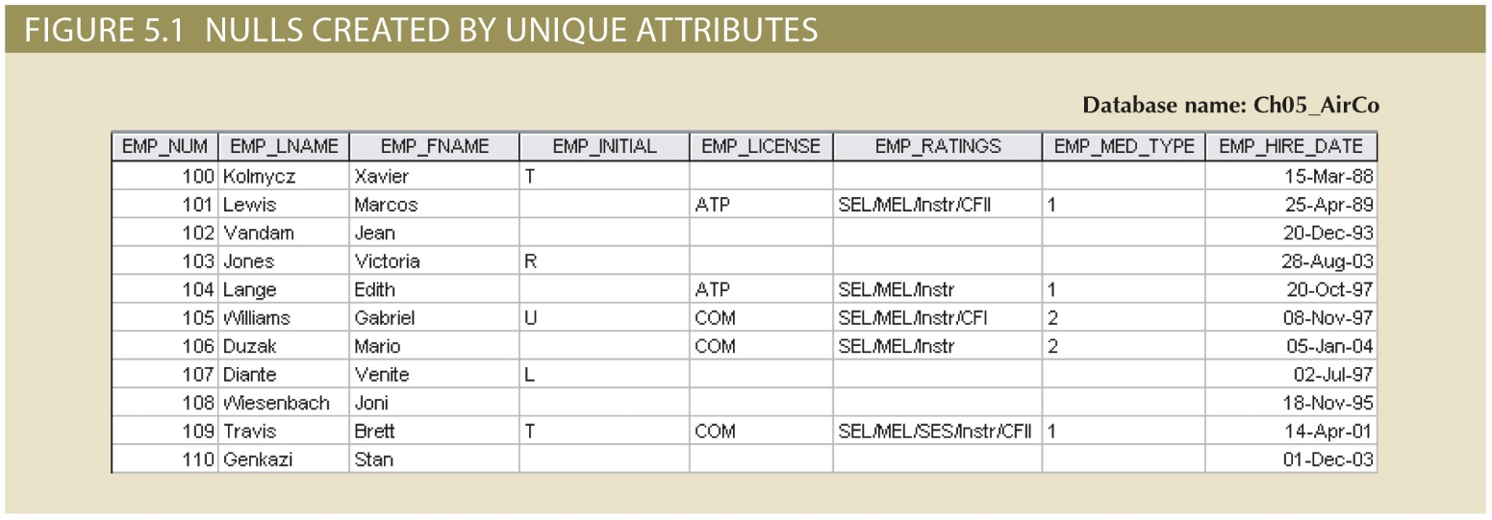
Copyright © 2017 Cengage Learning
5

Slide 6
Specialization Hierarchy
Depicts arrangement of higher-level entity supertypes and lower-level entity subtypes
Relationships described in terms of “IS-A Kind Of” relationships
Subtype exists only within context of supertype
Can have many levels of supertype/subtype relationships
More than 4 rare
Copyright © 2017 Cengage Learning
6

Slide 7
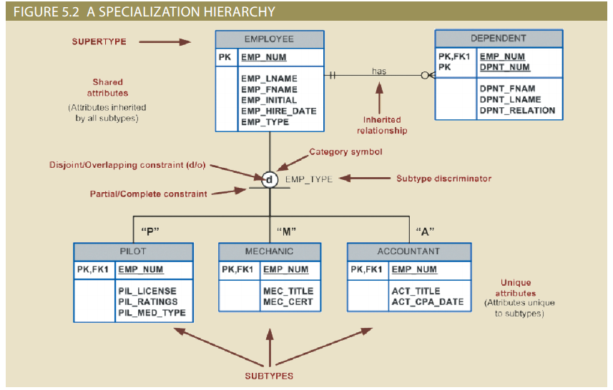
Copyright © 2017 Cengage Learning
7

Slide 8
Inheritance
Enables entity subtype to inherit attributes and relationships of supertype
All entity subtypes inherit their primary key attribute from their supertype
Really just a FK from sub to super
A supertype has 1:1 relationship with subtype(s)
Entity subtypes inherit all relationships in which supertype entity participates
Subtypes inherit all attributes and relationships from all upper-level supertypes, e.g., super of super.
Copyright © 2017 Cengage Learning
8

Slide 9
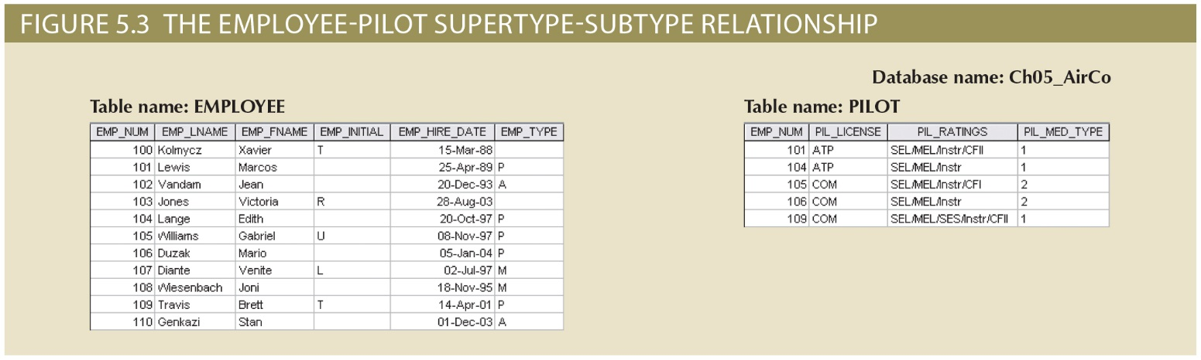
Copyright © 2017 Cengage Learning
9

Slide 10
Subtype Discriminator
Attribute in supertype entity
Determines which entity subtype each supertype instance/occurrence is related
Default comparison condition for subtype discriminator attribute is equality comparison
Subtype discriminator may be based on other comparison condition
Selecting the rows in the super that match a value of the discriminator identifies the set of keys for the subclass represented by that value, then join to subclass for its attributes
Copyright © 2017 Cengage Learning
10

Slide 11
Disjoint and Overlapping Constraints
Disjoint subtypes
Also called nonoverlapping subtypes
Subtypes that contain unique subset of supertype entity set
Each thing of the world is either one subtype or another, but not multiple subtypes
Overlapping subtypes
Subtypes that contain nonunique subsets of supertype entity set
One thing/object in the world is also both of the subtypes
Copyright © 2017 Cengage Learning
11

Slide 12
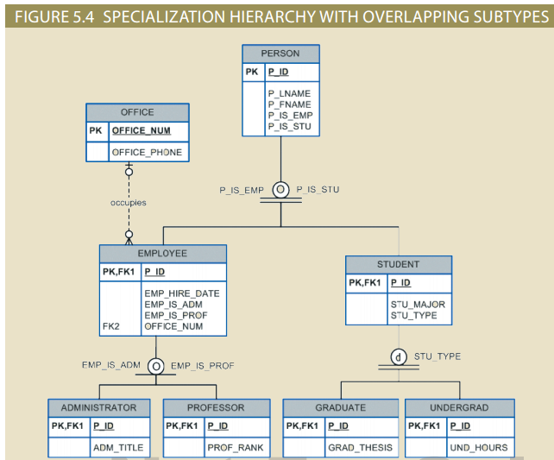
Copyright © 2017 Cengage Learning
12

Slide 13
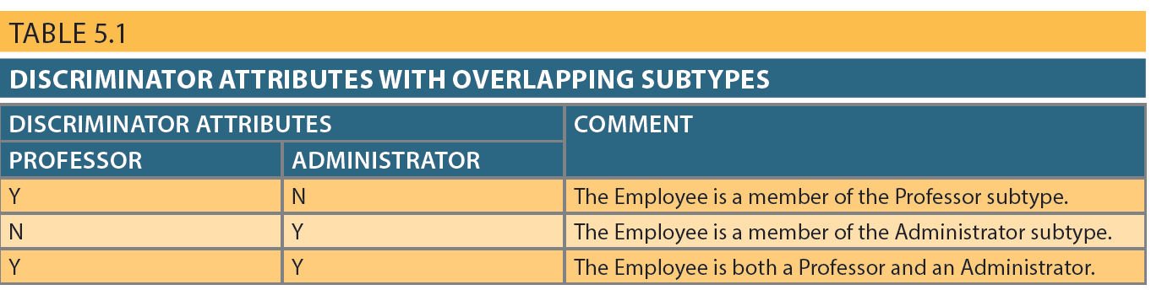
Subtype Discriminators
Copyright © 2017 Cengage Learning
13

Slide 14
Completeness Constraint
Specifies whether a supertype instance must have a matching instance in at least one subtype
Partial completeness
Symbolized by a circle over a single line
Some supertype instances have no matching instances in any subtype
Total completeness
Symbolized by a circle over a double line
Every supertype instance must have a matching instance in any subtype
Copyright © 2017 Cengage Learning
14

Slide 15
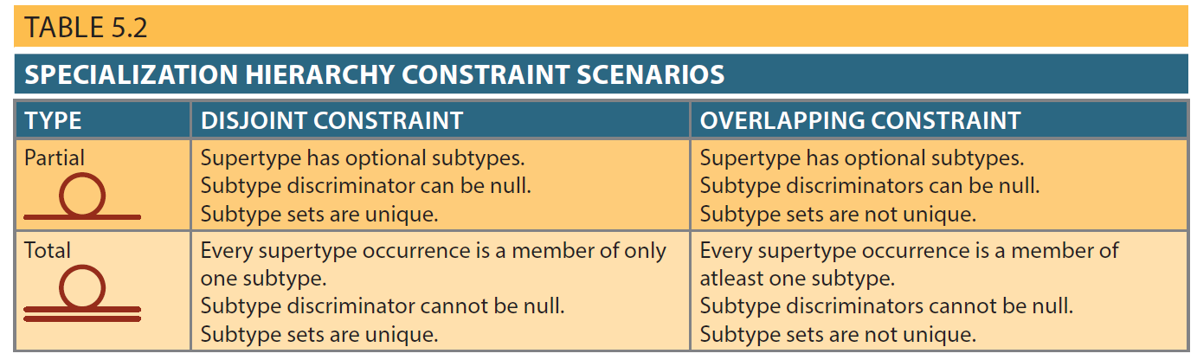
Copyright © 2017 Cengage Learning
15

Slide 16
Specialization and Generalization
Specialization
Identifies more specific entity subtypes from higher-level entity supertype
Top-down process
Based making subtypes for unique characteristics and relationships
Generalization
Identifies more generic entity supertype from lower-level entity subtypes
Bottom-up process
Based on grouping common characteristics and relationships of the subtypes
Copyright © 2017 Cengage Learning
16

Slide 17
Entity Clustering
“Virtual” entity type used to represent multiple entities and relationships in ERD
Considered “virtual” or “abstract” because it is not actually an entity in final ERD
Temporary entity used to represent multiple entities and relationships
Reduce model complexity
Eliminate undesirable consequences
Avoid display of attributes when entity clusters are used
Copyright © 2017 Cengage Learning
17

Slide 18
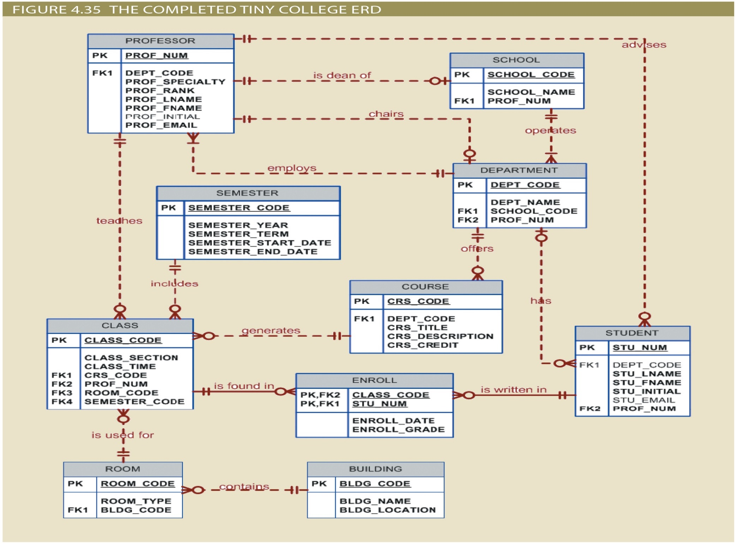
Copyright © 2017 Cengage Learning
18

Slide 19
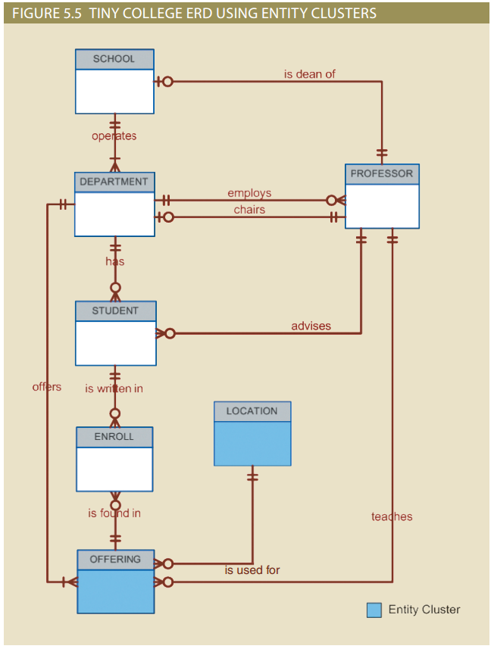
Copyright © 2017 Cengage Learning
19

Slide 20
Summary
Extended entity relationship (EER) model adds semantics to ER model
Adds semantics via entity supertypes, subtypes, and clusters
Specialization hierarchy
Depicts arrangement and relationships between entity supertypes and entity subtypes
Inheritance means an entity subtype inherits attributes and relationships of supertype
Subtype primary key is foreign key to supertype primary key
Copyright © 2017 Cengage Learning
20

Slide 21
Summary (cont’d.)
Subtype discriminator determines which entity subtype a supertype instance is related to:
Partial or total completeness
Specialization vs. generalization
Entity cluster is “virtual” entity type
Represents multiple entities and relationships in ERD
Formed by combining/collapsing multiple interrelated entities and relationships into a single object
Copyright © 2017 Cengage Learning
21

Slide 22
Task
Sketch/create an ERD for a supertype subtype hierarchy not presented in the book. Specify whether it partial or total and overlapping or disjoint.
Copyright © 2017 Cengage Learning
22

